Slide 1

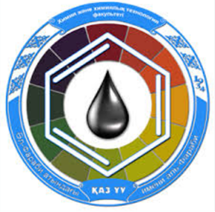
Isomerism of coordination compounds.
Al-Farabi Kazakh National University
Faculty of Chemistry and Chemical technology
Department of General and Inorganic Chemistry
PhD Bakhadur Askar

Slide 2
Isomerism in coordination chemistry
Isomerism is the phenomenon in which two or more compounds have the same chemical formula but different arrangements of atoms.
In coordination chemistry, this leads to compounds that have identical compositions but differ in physical or chemical properties.
Isomerism reflects the spatial or structural variability of metal–ligand bonding.
The study of isomerism helps in understanding reactivity, color, magnetism, and biological activity of coordination complexes.
Coordination compounds display two broad categories of isomerism:
  Structural (constitutional) isomerism
  Stereoisomerism

Slide 3
Classification of isomerism
Isomerism in coordination compounds can be divided as follows:
I. Structural Isomerism
Ionization isomerism
Hydrate (solvate) isomerism
Coordination isomerism
Linkage isomerism
II. Stereoisomerism
Geometrical isomerism
Optical isomerism
Each type results from a distinct way of arranging ligands, metal centers, or donor atoms in the coordination sphere.

Slide 4
Structural (constitutional) isomerism
1. Ionization Isomerism
Occurs when exchange between ligands inside and outside the coordination sphere results in different ions in solution.
Example:
[Co(NH₃)₅Br]SO₄ ↔ [Co(NH₃)₅SO₄]Br
These isomers yield different ions when dissolved in water.
2. Hydrate (Solvate) Isomerism
Differs by the position of water molecules — inside or outside the coordination sphere.
Example:
[Cr(H₂O)₆]Cl₃ (violet), [Cr(H₂O)₅Cl]Cl₂·H₂O (green), [Cr(H₂O)₄Cl₂]Cl·2H₂O (green).
The number and position of water molecules affect color and conductivity.

Slide 5
More structural isomerism
3. Coordination Isomerism
Occurs in compounds containing both cationic and anionic complexes where ligands exchange between them.
Example:
[Co(NH₃)₆][Cr(CN)₆] ↔ [Cr(NH₃)₆][Co(CN)₆]
4. Linkage Isomerism
Occurs with ambidentate ligands that can bind through different donor atoms.
Example:
[Co(NH₃)₅(NO₂)]Cl₂ (nitro) and [Co(NH₃)₅(ONO)]Cl₂ (nitrito).
These exhibit different colors and infrared spectra due to distinct metal–ligand bonds.

Slide 6
Stereoisomerism: geometrical isomerism
Occurs when ligands are arranged differently in space around the metal center, but the connectivity remains identical.
Examples:
Square planar (coordination number 4):
[Pt(NH₃)₂Cl₂] → cis and trans isomers.
  Cis form: ligands adjacent (90° apart).
  Trans form: ligands opposite (180° apart).
  (Cisplatin is the anticancer drug; transplatin is inactive.)
Octahedral complexes:
[Co(NH₃)₄Cl₂]⁺ → cis and trans forms.
[Cr(en)₃]³⁺ → fac and mer isomers when ligands are different.
Geometrical isomerism strongly influences color, dipole moment, and biological activity.

Slide 7
Stereoisomerism: optical isomerism
Optical isomers, or enantiomers, are non-superimposable mirror images of each other.
They rotate the plane of polarized light in opposite directions — one dextrorotatory (d), the other levorotatory (l).
Common in:
Octahedral complexes with bidentate ligands such as ethylenediamine (en) or oxalate.
Example: [Co(en)₃]³⁺ has Δ (delta) and Λ (lambda) isomers.
Optical activity is crucial in bioinorganic chemistry, since many enzymes and drugs interact selectively with one enantiomeric form.

Slide 8

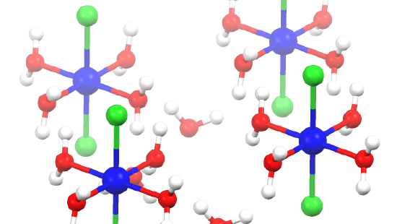
Importance
Isomerism in coordination compounds is essential for:
Medicinal chemistry: Activity depends on isomer type (cisplatin vs. transplatin).
Catalysis: Stereochemical arrangement determines reactivity and selectivity.
Bioinorganic systems: Metal centers in proteins (e.g., hemoglobin, vitamin B₁₂) exhibit coordination isomerism.
Materials science: Optical isomers used in chiral materials and asymmetric synthesis.
Understanding isomerism aids in designing functional materials and targeted pharmaceuticals.

Slide 9
SUMMARY
Isomerism in coordination chemistry arises from different arrangements of identical atoms or ligands.
Structural isomerism involves different connectivity (ionization, hydrate, coordination, linkage).
Stereoisomerism involves different spatial arrangements (geometrical and optical).
Geometrical isomers affect physical and chemical properties, while optical isomers show chirality and optical activity.
Isomerism plays a vital role in chemical reactivity, spectroscopy, catalysis, and biological activity.

Slide 10

Thank you for attention!

